Slide 1
DevOpsing in a Microsoft World
Notes:
Good afternoon, I'm Scott Nasello !
Who's ready to talk about DevOpsing in a Microsoft World?

Slide 2
“A 5 hour road trip to an amusement park on the hottest day of the year”
Notes:
It’s not like that perfect vacation that you bought through that vacation planner you heard great things about. That trip that starts off great and maintains and exceeds your expectations throughout, knowing where you’re going, how you’re going to get there, and what you’re going to do. Where you make in instant connection with the taxi driver on the way to dinner and they suggest that you dine at a different restaurant and you forever have the satisfaction knowing that it was the better choice. That vacation where your partner repeatedly praises you throughout for your flawless planning and execution.
It’s really like that vacation your mom planned, to take you and a couple friends to the amusement park a short 5 hour drive away on the hottest August day of the summer. That’s the trip you learn that one of your neighbor friends is really weird, someone was inevitably going to throw up in the car and others are going to follow, your mom is going to power you through it, and the family truckster will take some messy hits. But you’re glad you didn’t miss the opportunity to hit that park and now you know how weird your neighbor is. And as long as you have that car, you will know where to look to see those stains that will remind you of that trip.

Slide 3
DevOps Challenges
Normal, rational hesitation to widespread change
Functional silos, organizational alignment
Typical Agile-Lean-DevOps (ALDO) challenges
Typical
Organization
+
Monolithic tools, screenshots, “click next”
Closed source, undocumented APIs, friction
Reliance on vendors for direction, road mapping
Silos encouraged by Microsoft
“Microsoft”
Organization
+
Commercial Off The Shelf (Buy vs. Build)
Limited engineering tradition
Buy vs Build
Organization
Notes:
Microsoft has changed quite a bit under Satya via Azure and PowerShell, however many enterprises likely have substantial residue remaining

Slide 4
Core Challenge:
Enduring DevOps transformations require a commitment to learning
Notes:
Regardless of the background, all organizations share a common challenge:

Slide 5
“A learning organization is an organization skilled at creating, acquiring, and transferring knowledge, and at modifying its behavior …”
- Professor David A. Garvin, HBS

Slide 6
If you want to “do the DevOps” and don’t have a learning organization, what do you do?

Slide 7
Hypothesis:
The pain/difficulty of developing a growth mindset (in a DevOps context) as an adult is not well understood or documented

Slide 8
Interviews:
Describe Journey
Favorite/least favorite aspect
Advice to the 2015 you
Anticipating in next 2 years
Notes:
How would you describe the journey we’ve been own over the last 2 years?
What’s been your favorite aspect of this journey?
What’s been your least favorite aspect of this journey?
What would you tell your “2015 self” about the journey you are about to go on?
What are you most eagerly anticipating over the next 2 years?

Slide 9
The Journey:
Rewarding, bumpy, and lots of self doubt, I definitely felt like an imposter. Eventually: “I felt like I could grow/contribute”

Slide 10
The Journey:
Team has grown quite a bit but can regress to old ideas and mindsets; Learned quite a bit about dealing with folks I don’t agree with

Slide 11
The Journey:
Hard to ramp up due to the slew of tools, behaviors, and new ways of thinking (especially for windows admins)

Slide 12
Favorite Aspect:
I have enjoyed expanding my sphere of responsibilities and interests by breaking down IT silos. The variety and level of activity within the team has been rejuvenating

Slide 13
Favorite Aspect:
I enjoy being on the leading edge of enterprise IT. DevOps is not new for unicorns but is still in beginning stages in Microsoft centric enterprises

Slide 14
Favorite Aspect:
The encouragement to experiment (fail) without the fear of punishment, especially with ChatOps

Slide 15
Favorite Aspect:
People, Teammates, Mentorship, Learning to ask for help; Developing confidence

Slide 16
Least Favorite Aspect:
Constant change...all the experiments, not enough time to go deep
Notes:
Constant change… all the experiments, not enough time to go deep
Adapting to change is difficult, especially for those in the field for many years
Not being able to devote enough time to new work
Feeling lost/helpless, discomfort due to width and breadth of areas
Windows makes it harder than it needs to be
Lack of prioritization across projects
The lack of time to experiment with technologies outside my immediate areas of responsibility has been frustrating

Slide 17
Least Favorite Aspect:
Feeling lost/helpless, discomfort due to width and breadth of areas
Notes:
Constant change… all the experiments, not enough time to go deep
Adapting to change is difficult, especially for those in the field for many years
Not being able to devote enough time to new work
Feeling lost/helpless, discomfort due to width and breadth of areas
Windows makes it harder than it needs to be
Lack of prioritization across projects
The lack of time to experiment with technologies outside my immediate areas of responsibility has been frustrating

Slide 18
Least Favorite Aspect:
Lack of prioritization across projects, maintenance, support

Slide 19
Advice to 2015 self:
Be prepared to disappoint someone, It could be your manager, the business, your teammate, or yourself
Notes:
Over the next two years, you’re going to have to disappoint someone - It could be your manager, it could be the business, it could be your teammates, it could be your family, it could be yourself. You’re already at 100% and changing the way you work will seem like adding another 30% of work. Choose wisely who you disappoint, and remember that you’re not in this transformation alone – sacrifice a little of your teammates sanity when yours is depleted cause it will require that kind of team effort. Spend some time assisting the business units you support to be more self-sufficient – give them the tools and rights to help themselves so that you can focus on the true elements of infrastructure. The near future and speed of infrastructure isn’t going to allow itself to be built and maintained by a Microsoft Wizard that simplifies the process and guides you through every procedure – even MS is rapidly changing its toolsets in response to the reinvention of IT infrastructure. If you have any doubts, review what the sessions are at MS Ignite these days.

Slide 20
Advice to 2015 self:
Don’t be overwhelmed by DevOps nirvana...try to stay focused on incremental improvements. Each improvement is like a savings deposit that will compound over time

Slide 21
Advice to 2015 self:
Prepare for a lot of change; be willing to embrace the change; Reflect on why you do things...is it still valid? Was it ever valid?

Slide 22
Advice to 2015 self:
Your existing skills are becoming obsolete and your expertise is at risk; Find a way to get started on new ideas

Slide 23
Anticipating:
Public Cloud
CHEF all the things
Automation

Slide 24
Additional questions:
Career progression
Educational background
Vendor certifications

Slide 25
Observation:
Many veteran “IT Pros” started their career in help desk, advanced through the ranks, and likely bypassed college.

Slide 26
If you want to “do the DevOps” and don’t have a learning organization, what do you do?

Slide 27
Hypothesis:
DevOps practices can be used to teach the organization to become a learning organization
Notes:
The Westrum Model
typology developed by Ron Westrum, a sociologist who found that organizational culture was predictive of safety and performance outcomes in the healthcare industry. Westrum developed a typology of organizational cultures that includes three types of organizations:
* Pathological (power-oriented). These organizations are characterized by low cooperation across groups and a culture of blame. Information is often withheld for personal gain.
* Bureaucratic (rule-oriented). Bureaucratic cultures are preoccupied with rules and positions, and responsibilities are compartmentalized by department, with little concern for the overall mission of the organization.
* Generative (performance-oriented). The hallmarks of a generative organization are good information flow, high cooperation and trust, bridging between teams, and conscious inquiry.

Slide 28
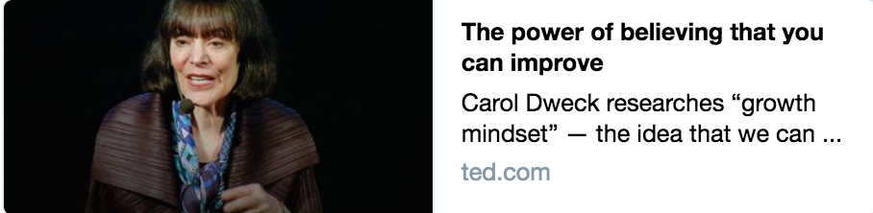
Let's not waste any more lives¹, because once we know that abilities are capable of such growth, it becomes a basic human right for children², all children², to live in places³ that create that growth, to live in places³ filled with "yet".
¹ careers
² people
³ workplaces

Slide 29
Let's not waste any more lives¹, because once we know that abilities are capable of such growth, it becomes a basic human right for children², all children², to live in places³ that create that growth, to live in places³ filled with "yet".
¹ careers
² people
³ workplaces

Slide 30
Let's not waste any more careers, because once we know that abilities are capable of such growth, it becomes a basic human right for people, all people, to live in workplaces that create that growth, to live in workplaces filled with "yet".
¹ careers
² people
³ workplaces

Slide 31
SWOT Analysis ~2014
Strengths Vendor partnerships Exceptionally tight knit teams Expertise in storage & virtualization Strong operational background Entrepreneurial DNA Low turnover in team 99% virtualized with high availability
Weaknesses Reliance on vendors (COTS, Microsoft) Single threaded in numerous technologies Substantial legacy footprint Large population of long-lived servers Organization not “product” oriented Decentralized internal customers Low standardization / automation
Opportunities Centralized Infrastructure Engineering Under-challenged IT Pros 2 Engineers with scripting capabilities
Threats Potential disruption in retail

Slide 32
Public Service Announcement:
Your mindset as a leader matters
Notes:
The role of a leader in the learning organization is that of a designer, teacher, and steward who can build shared vision and challenge prevailing mental models. He is responsible for building in which the employees are continually expanding their capabilities to shape their future — that is, leaders are responsible for learning.
Do you believe in your team?
Do you have the humility to let your teams see you failing/growing?
Are you prepared to lead by example?
Servant Leadership
Scott at Summer Camp
Herbie (The Goal)
Crawl Walk Run
Leave no engineer behind
Lead by Example + Role Model what you want / Reap what you sow
I’ve said it before, I really don’t like public speaking
BE+KNOW+DO
BE: Character as a leader & courage to lead
KNOW: skills sets
DO: Leaders act: they provide purpose, direction, motivation

Slide 33
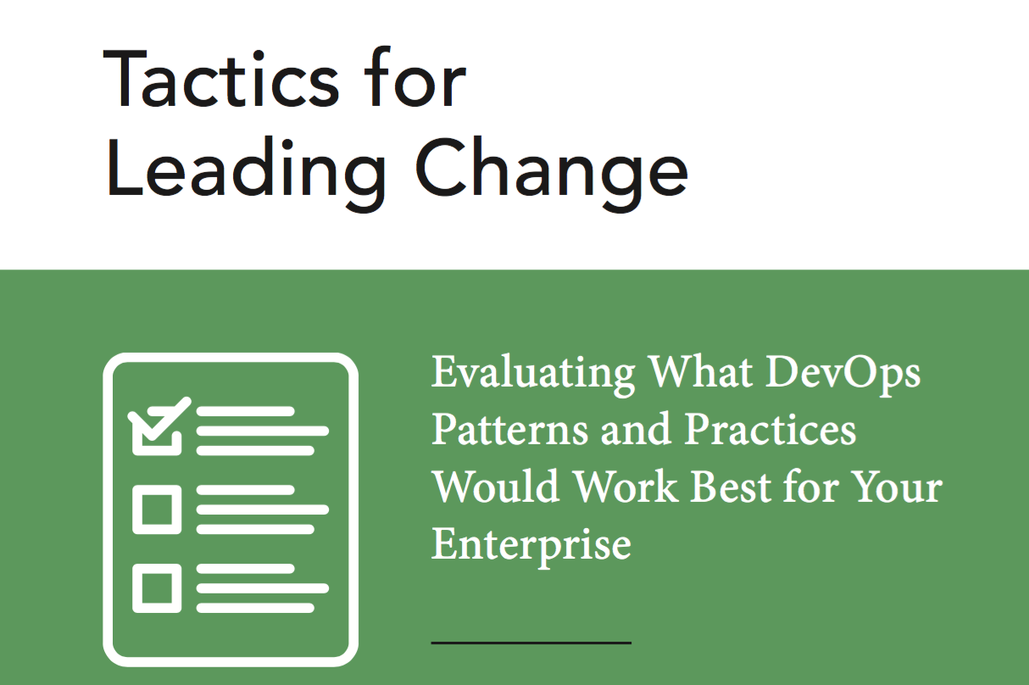
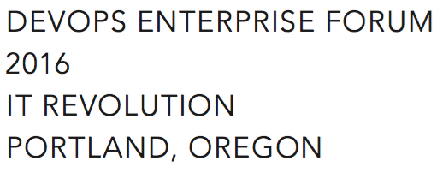
Small batch DevOps®
Make a compelling case for change (Tactic 14)
DevOps information sessions (Tactic 2)
Make Work Visible (Tactic 11) – TFS Kanban
Experiments (Tactic 4) – vRA for IaaS
Gemba Walks (Tactic 9)
Later
Blameless Retrospectives (Tactic 5)
Set WIP Limits (Tactic 13)
Notes:
Tactics for Leading Change wasn’t available when we started but many of the early patterns are well-represented in the
Without accompanying changes in the way that work gets done, only the potential for improvement exists – David A. Garvin

Slide 34
Learning Org progression
Cognitive - 2015
Exposed to new ideas, expand their knowledge and begin to think differently.
Behavioral - 2016
Employees internalize new insights and alter behavior.
Performance Improvement - 2017
Changes in behavior leading to measurable improvements in results.

Slide 35
2015
Q1 Daily Standup → Weekly Standup TFS Kanban TFS Version Control : Goal 250 artifacts Conferences – spread wealth DevOps in a Microsoft World (Snover) Primary / Alternate engineer swaps
Q2 CHEF Conf 2015 x 10 Phoenix Project suggested reading Nordstrom reference calls PS & VMware vCloud Automation Center Prepare Workspace (TFS, .Net, PS, ChefDk) CHEF POC
Q3 Enterprise CHEF contract (700 nodes) Weekly Demos DSC Server provisioning (PoshOrigin) Difficulty stabilizing tools, automation Height of frustration ☹ PowerShell onsite training
Q4 Simplified PoshOrigin: WSIWYG CHEF Greenfield via Server provisioning Automation for ransomware remediation Curious people series Desktop PowerShell module CHEF: 100+ Greenfield Servers 500+ artifacts in version control

Slide 36
2016
Q1 Greenfield N-Tier App with CHEF CHEF onsite training Slack experimentation Work visibility & analytics – TFS + PowerShell Clean up ticketing system vRA, NSX, etc. investigation All in one monitoring solution
Q2 Exploration: PS script consumption Automation: psake, pester, Artifactory Stretched vSAN cluster Data Center migration via automation PowerShell module to manage TFS Kanban Community: DevOpsDays Portland Sponsor CFPs for tech conferences
Q3 Ideas: VelocityConf - ChatOps & Rotations Book: “Team of Teams” McChrystal Organization: Cross functional re-org SCM: GitLab – version control & CI/CD ChatOps: CHEF + Hubot + Slack + GitLab Automation: O365 Exchange in Cloud
Q4 Exploration: scripting for AWS/Azure, EMC Challenges: Loadbalancer pains, SOX 404 CHEF: 500+ Servers & CHEF Automate ChatOps: 150+ scripts, “Etsy Day 1”, demos Friction: Prioritization, Principles Org: Hiring great engineers, rotations

Slide 37
2017
Organization
Cross-functional teams “Pods” of 4 to 5 that rotate
Scheduled weekly retrospectives – ITSM Queue, Notable incidents/projects
ChatOps
“We should create a RYU for that”
Demo with Microsoft’s Teams Product leadership
Contributions from other orgs
Slack Rules of Engagement (Skype For Business, Workplace, etc.)
Azure Management & Costing, NetScaler, SharePoint, Teradata, Commvault, EMC, VMAX migrations
Azure PaaS Exploration
10 Proofs of Concept in flight, GitLab CI (Terraform/ARM)
Emerging ”cloud first” orientation
Deferred Capital re-investment in Colocation facilities
Green/Blue
NetScaler, SAP Application Servers
CHEF
”Brownfield”, 1300+ Servers, Sensu cookbook, Security / Compliance CIS cookbooks
Notes:
Excited because ChatOps is transformative.

Slide 38
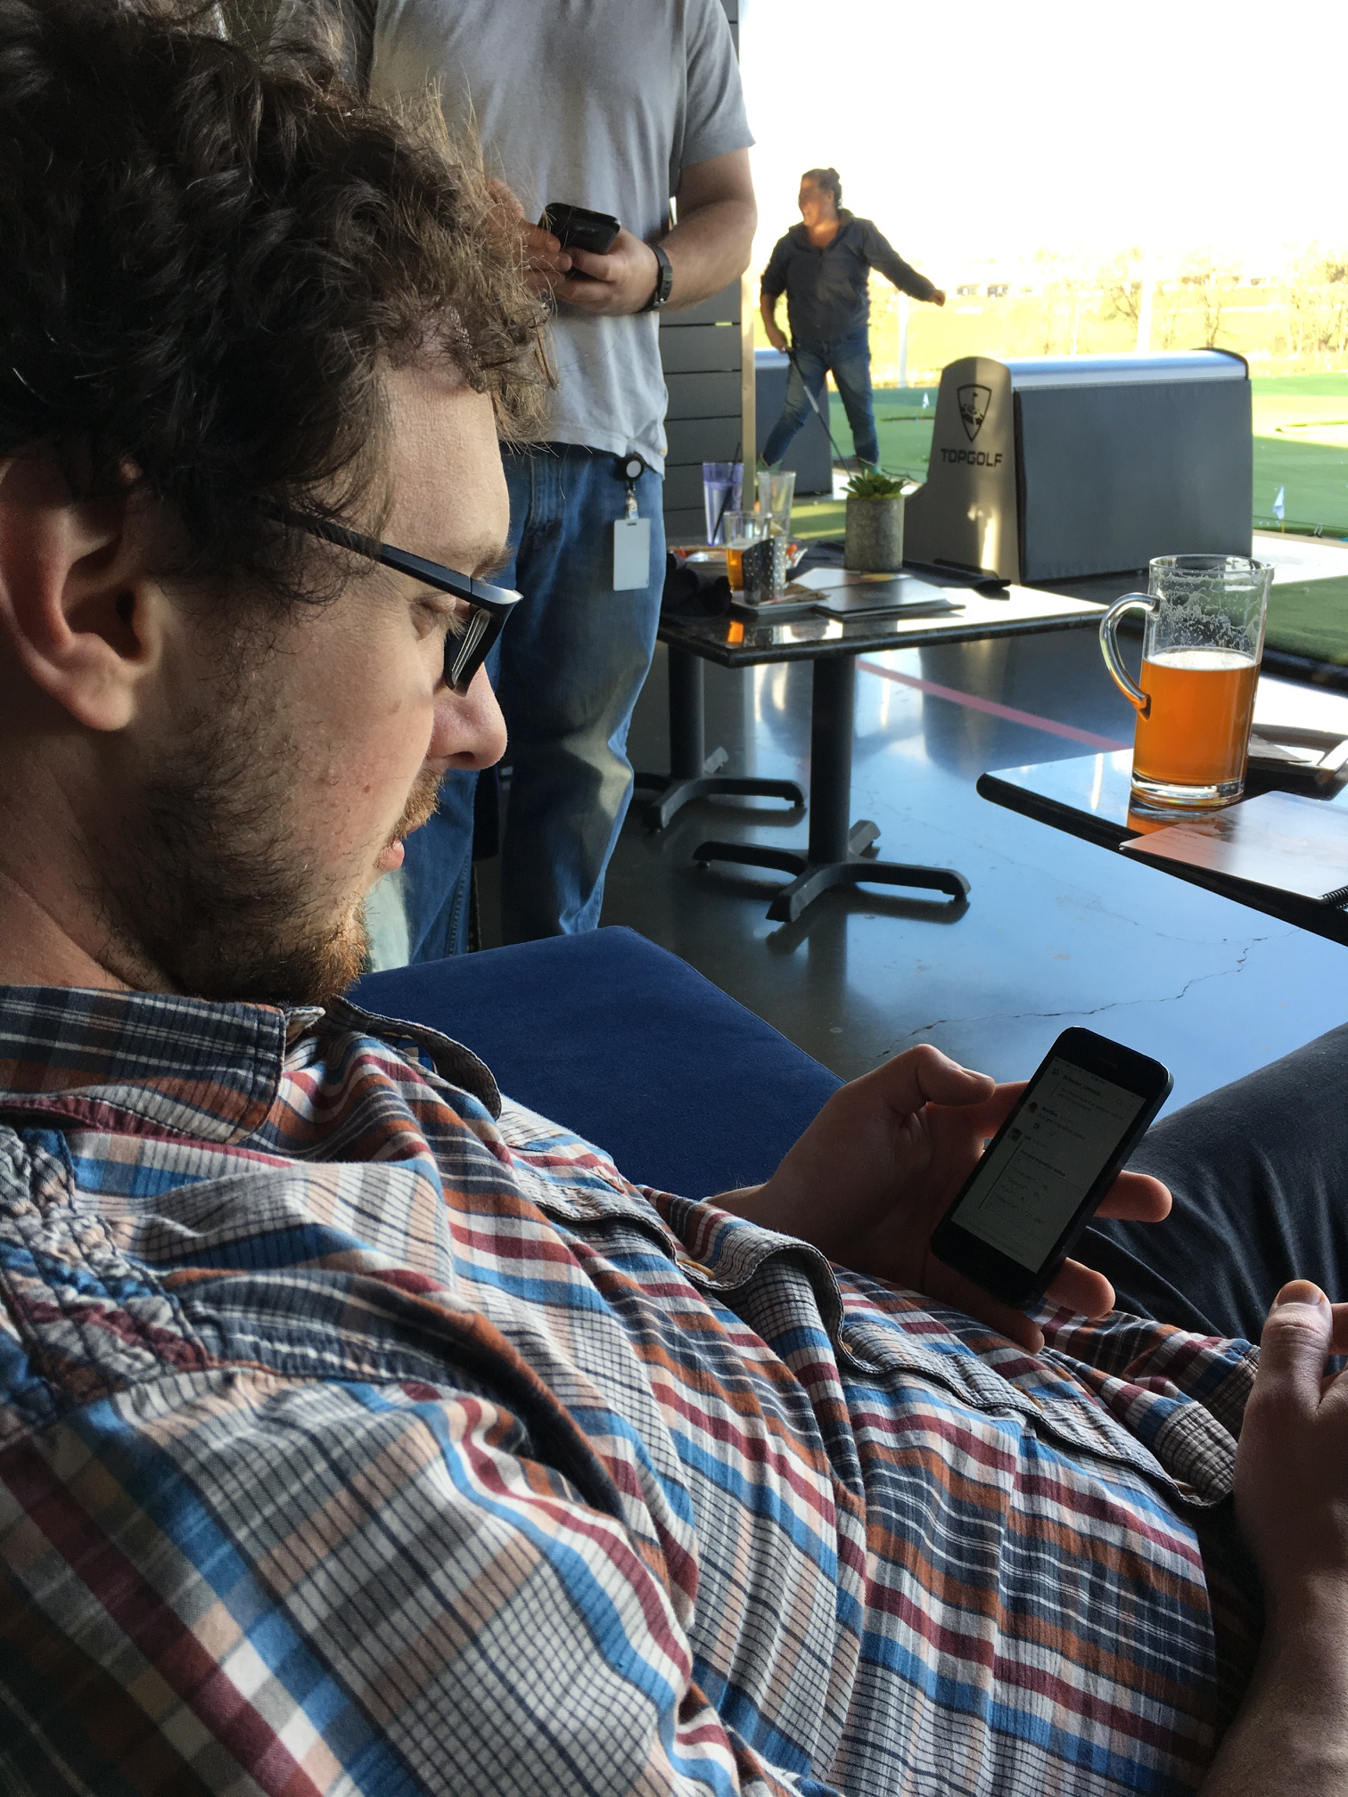
ChatOps

Slide 39
Scheduled Weekly Retrospectives

Slide 40
Learning Labs

Slide 41
Hypothesis:
DevOps practices can be used to teach the organization to become a learning organization

